Slide 1
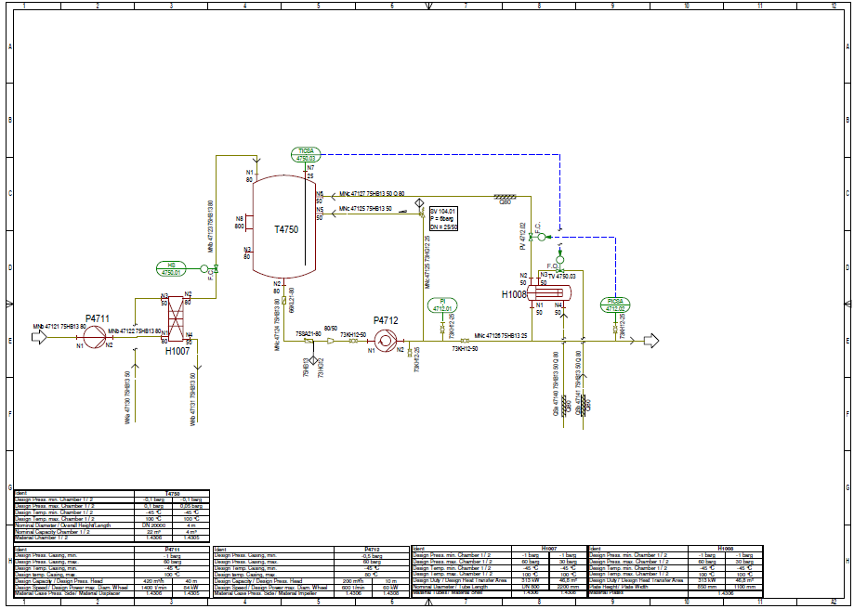
C01V01
This TestCase is about the full DEXPI Main P&ID Use Case.
Alle Disciplines are included:
Equipment
Piping
Instrumentation & Electrical
All Symbols are intelligent.
The ShapeCatalogue is used completely.
The Data Tables are filled automatically

Slide 2
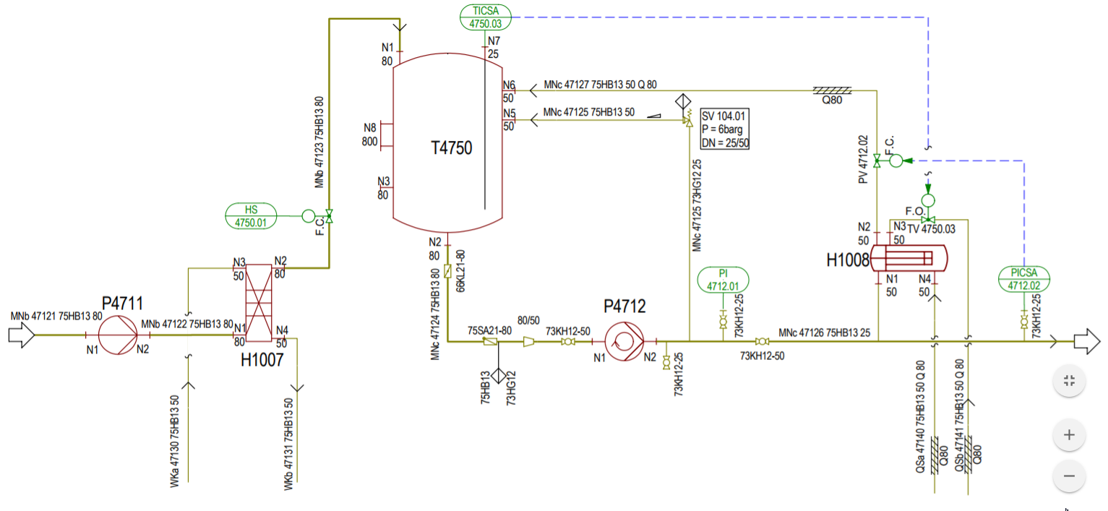
Detailed graphics of C01V01

Slide 3
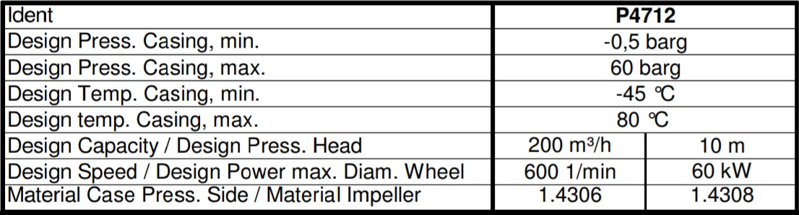
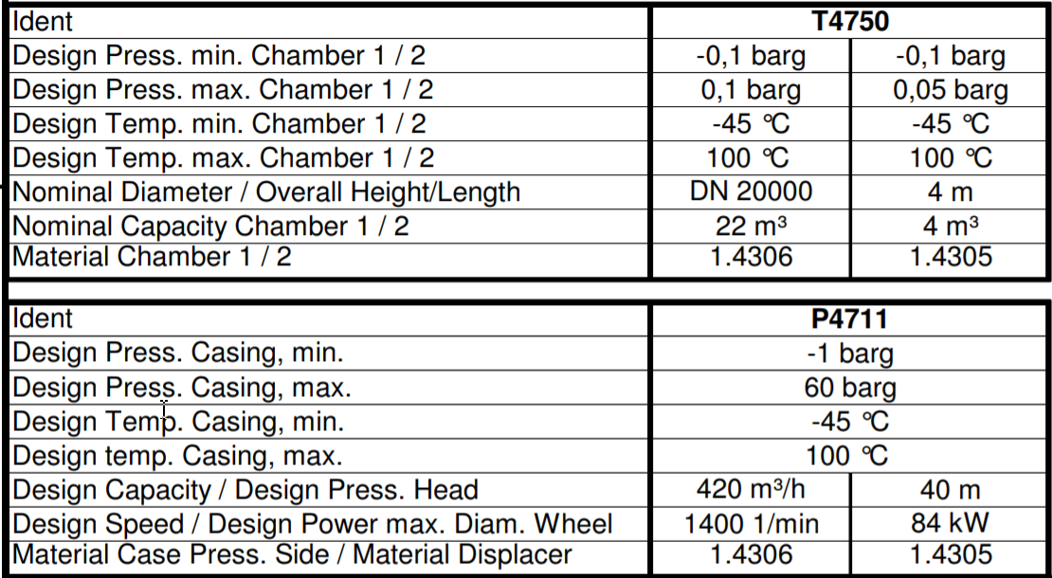
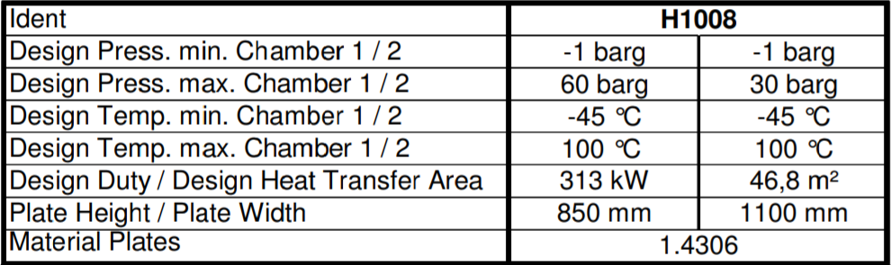
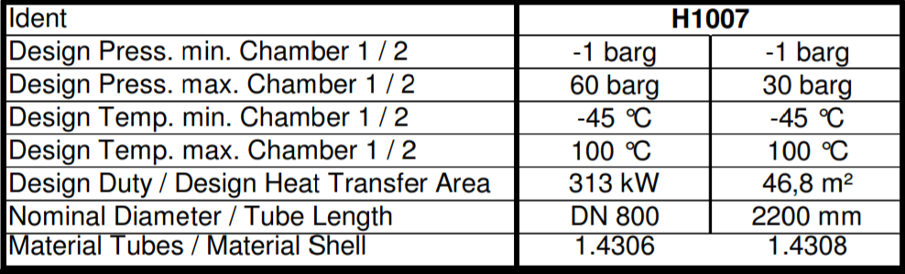
Detailed Tables of C01V01

